Slide 1
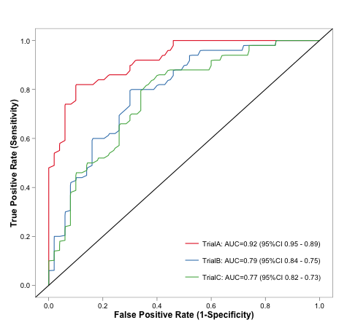
Evaluating Model Performance Lantz Ch 10
Right – Graphing is often used to evaluate results from different variations of an algorithm. Depending on how important false positives are, one or another of the points shown might be best.
Wk 5, Part 2
Notes:
Image from http://statistical-research.com/spatial-clustering-with-equal-sizes/

Slide 2
A truckload of tricks
Lantz warns us that, in different domains, different ways are preferred, of deciding what results are “best”.
Includes many types of summary statistics, graphing for visual decisions, etc.
Our goal – you know where to look up and calculate any of these, if someone says, “Oh, and what’s the precision on that?” Etc.

Slide 3
Classifiers - Main types of data involved
Actual class values
Predicted class values
Estimated probability of the prediction
If two methods are equally accurate, but
One is more able to assess certainty, then
It is the “smarter” model.

Slide 4
Let’s look at ham vs spam again
> sms_results <- read.csv("/Users/chenowet/Documents/Rstuff/sms_results.csv")
> head(sms_results)
actual_type predict_type prob_spam
1 ham ham 2.560231e-07
2 ham ham 1.309835e-04
3 ham ham 8.089713e-05
4 ham ham 1.396505e-04
5 spam spam 1.000000e+00
6 ham ham 3.504181e-03
This model is very confident of its choices!

Slide 5
How about when the model was wrong?
> head(subset(sms_results, actual_type != predict_type))
actual_type predict_type prob_spam
53 spam ham 0.0006796225
59 spam ham 0.1333961018
73 spam ham 0.3582665350
76 spam ham 0.1224625535
81 spam ham 0.0224863219
184 spam ham 0.0320059616
Classifier knew it had a good chance of being wrong!

Slide 6
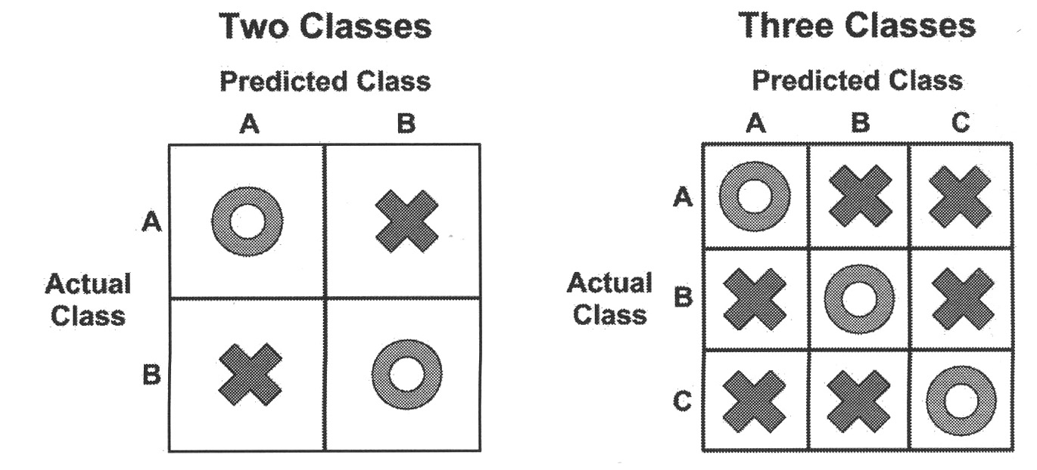
Confusion matrices tell the tale
We can judge based on what mistakes the algorithm made,
Knowing which ones we care most about.
Notes:
Lantz p 298

Slide 7
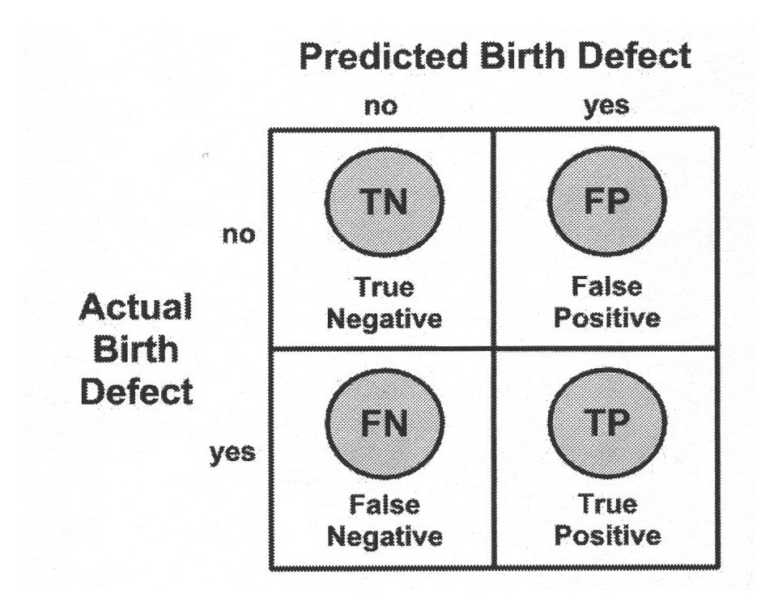
E.g., predicting birth defects
Which kind of error is worse?
Notes:
Lantz p 299

Slide 8
A common, global figure from these confusion matrices
An overall way to decide “accuracy” of an algorithm?
Like, what percent is on the diagonal in the confusion matrix?
“Error rate” is then 1 – accuracy.

Slide 9
So, for ham & spam…
> CrossTable(sms_results$actual_type, sms_results$predict_type)
Cell Contents
|-------------------------|
| N |
| Chi-square contribution |
| N / Row Total |
| N / Col Total |
| N / Table Total |
|-------------------------|
Total Observations in Table: 1390
| sms_results$predict_type
sms_results$actual_type | ham | spam | Row Total |
------------------------|-----------|-----------|-----------|
ham | 1202 | 5 | 1207 |
| 16.565 | 128.248 | |
| 0.996 | 0.004 | 0.868 |
| 0.976 | 0.031 | |
| 0.865 | 0.004 | |
------------------------|-----------|-----------|-----------|
spam | 29 | 154 | 183 |
| 109.256 | 845.876 | |
| 0.158 | 0.842 | 0.132 |
| 0.024 | 0.969 | |
| 0.021 | 0.111 | |
------------------------|-----------|-----------|-----------|
Column Total | 1231 | 159 | 1390 |
| 0.886 | 0.114 | |
------------------------|-----------|-----------|-----------|
Accuracy = (154 + 1202 )/ 1390
= 0.9755
Error rate = 0.0245

Slide 10
“Beyond accuracy”
The “kappa” statistic
Adjusts accuracy by accounting for a correct prediction by chance alone.
For our spam & ham, it’s 0.8867, vs 0.9775
“Good agreement” = 0.60 to 0.80
“Very good agreement” = 0.80 to 1.00
Subjective categories
Notes:
Lantz p 303
Formula from http://en.wikipedia.org/wiki/Cohen's_kappa

Slide 11
Sensitivity and specificity
Sensitivity = “True positive rate”
and
Specificity = “True negative rate”
Notes:
From http://en.wikipedia.org/wiki/Sensitivity_and_specificity

Slide 12
For ham and spam…
> confusionMatrix(sms_results$predict_type, sms_results$actual_type, positive = "spam")
Confusion Matrix and Statistics
Reference
Prediction ham spam
ham 1202 29
spam 5 154
Accuracy : 0.9755
95% CI : (0.966, 0.983)
No Information Rate : 0.8683
P-Value [Acc > NIR] : < 2.2e-16
Kappa : 0.8867
Mcnemar's Test P-Value : 7.998e-05
Sensitivity : 0.8415
Specificity : 0.9959
Pos Pred Value : 0.9686
Neg Pred Value : 0.9764
Prevalence : 0.1317
Detection Rate : 0.1108
Detection Prevalence : 0.1144
Balanced Accuracy : 0.9187
'Positive' Class : spam

Slide 13
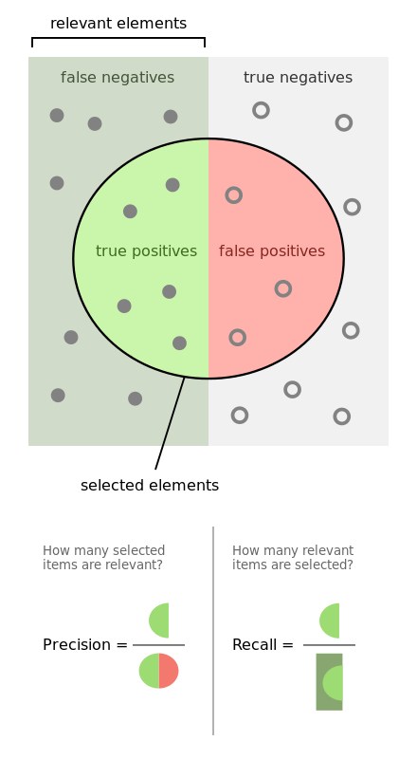
Precision and recall
Also measures of the compromises made in classification.
How much the results are diluted by meaningless noise.

Slide 14
The F-measure
The “harmonic mean” of precision and recall.
Also called the “balanced F-score.”
There are also F₁ and F_{β} variants!
Notes:
Formula from http://en.wikipedia.org/wiki/Precision_and_recall#F-measure

Slide 15
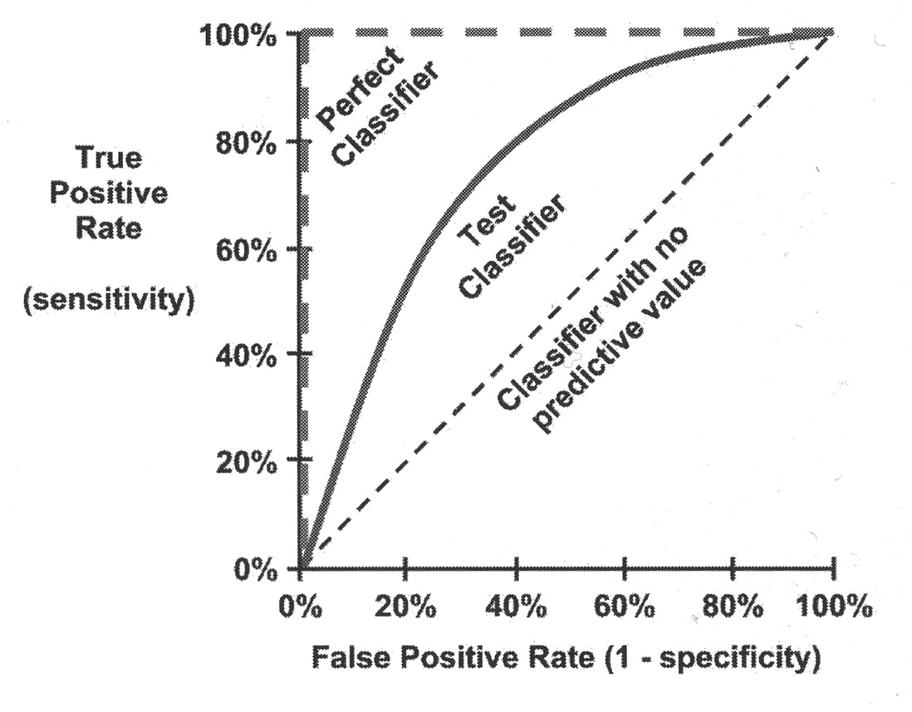
Visualizing
A chance to pick what you want based on how it looks vs other alternatives.
“ROC” curves – Receiver Operating Characteristic.
Detecting true positives vs avoiding false positives.
Area under the ROC curve varies from 0.5 (no predictive value) to 1.0 (perfect).
Notes:
Lantz p 312

Slide 16
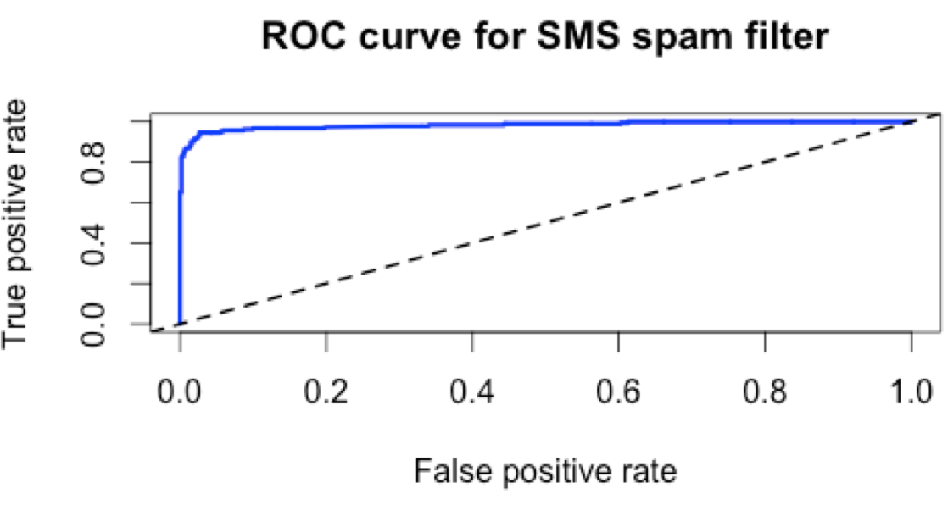
For SMS data
“Pretty good ROC curve”:

Slide 17
Further tricks
Estimating future performance by calculating the “resubstitution error.”
Lantz doesn’t put much stock in these.
The “holdout method.”
Lantz has used this throughout.
Except it recommends holding out 25% – 50% of the data for testing, and he’s often used much less.

Slide 18
K-fold cross validation
Hold out 10% in different ways, 10 different times.
Then compare results of the 10 tests.
“Bootstrap sampling” – similar, but uses randomly selected training and test sets.

